Slide 1
An introduction to Speech
CS425

Slide 2
Sound wave generation in the vocal system
There are three major mechanisms of excitation
1. Air flow from the lungs is modulated by the vocal cord vibration, resulting in a quasi-periodic pulse-like excitation
2. Air flow from the lungs becomes turbulent as the air passes through a constriction in the vocal tract, resulting in a noise-like excitation

Slide 3
Sound wave generation in the vocal system
3. Air flow builds up pressure behind a point of total closure in the vocal tract. The rapid release of this pressure causes a transient excitation

Slide 4
Sound wave generation in the vocal system
Given that the majority of speech sounds can be classed as either voiced or voiceless, in general terms what is required is a source that can produce either a quasi-periodic pulse waveform or a random noise waveform
A convenient way to represent the glottal wave is to use an impulse train generator that produces a sequence of impulses which are spaced by a desired fundamental period

Slide 5
Sound wave generation in the vocal system
This system in turn excites a linear system whose impulse response has a desired glottal wave shape
A gain control can set the intensity of the voiced excitation

Slide 6
Sound wave generation in the vocal system
For voiceless sounds the excitation model is much simpler
All that is required is a source of random noise and a gain parameter to control the intensity of the unvoiced excitation
For discrete-time models, a random number generator provides a source of flat spectrum noise.

Slide 7
A model for Speech Production
Switching between voiced and unvoiced generators, the mode of excitation can be changed
The vocal tract can be simply modelled using the combination of IIR filters

Slide 8
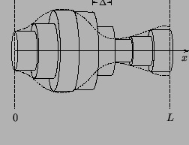
This assumes that the vocal tract can be approximated as a concatenation of a series of acoustic tubes, each contributing to the overall system's characteristics. It includes an overall gain term and models the system's resonances through the locations of complex poles, which collectively determine the filtered resonance characteristics of the entire tract.

Slide 9
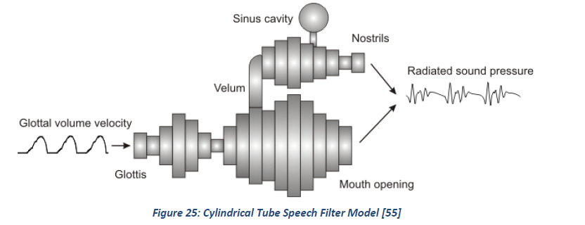

Slide 10
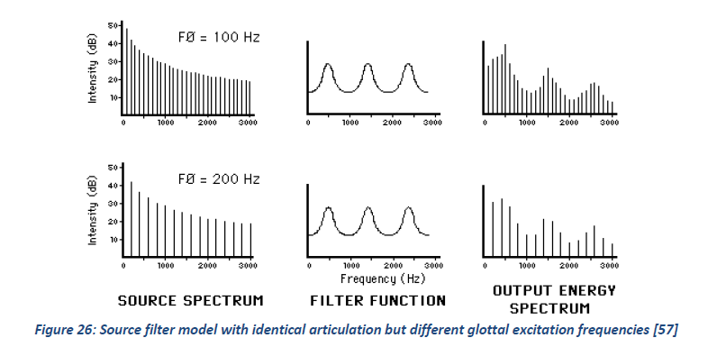

Slide 11
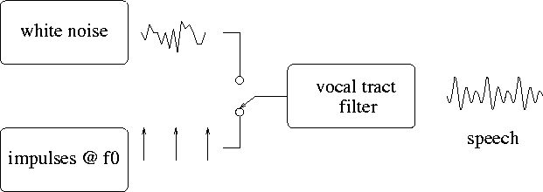
Extensions have been proposed to this model to include a more accurate representation of the glottal pulse shape and a stage to take account of the effects of the sound radiating at the lips

Slide 12
Model Limitations
For continuant sounds such as vowels where the model parameters vary very slowly, it can work very well. However, for transient sounds such as stops, the model is not as good but still adequate
The model assumes that the speech signal can be represented on a short-time basis, that is the parameters of the model are assumed to be constant over time-intervals typically 10-20 msec long

Slide 13
Model Limitations
2. The resonances within the oral side cavity do not amplify the resonances in the signal, but rather absorb resonances from the nasal tube.
Resonant frequencies that are close to the side cavities resonances in frequency get absorbed by the side cavity. The side cavity resonances are antiformants.
Anti-formants show up as amplitude valleys, not peaks, in the spectrum.

Slide 14
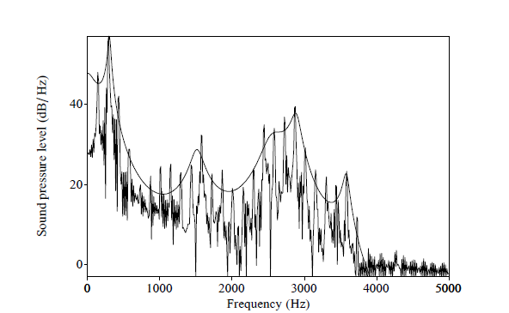
Spectrum of /m/
The anti-formant is shown by the valley is at 1094Hz

Slide 15
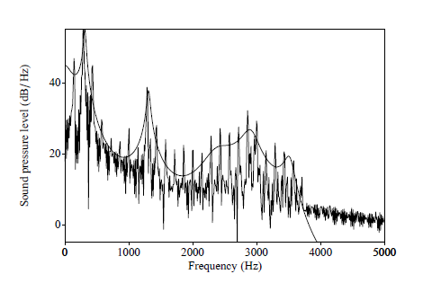
Spectrum of /n/
The anti-formant is shown by the valley is at 1750Hz

Slide 16
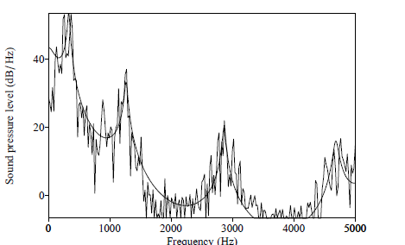
Spectrum of /l/ in leaf
The anti-formant is shown by the valley is at 2187Hz

Slide 17
Model Limitations
2. There is a lack of provision for spectral zeros in the linear speech model as required for nasals and fricatives. This is definitely a limitation for nasals but not too severe for fricatives

Slide 18
Model Limitations
3. The simple dichotomy of voiced-unvoiced excitation is inadequate for unvoiced fricatives. Simply adding the voiced and unvoiced excitations does not work as frication is correlated with peaks of glottal flow

Slide 20
Limitation No. 4
The model requires that the glottal pulses be spaced by an integer multiple of the sampling period T. This is shown in the figure.
For a sampling rate of 8000Hz, the three pulse trains have periods of 25, 24 and 26 samples respectively. This corresponds to a pitch frequency of 320, 333.33, and 307.7 Hz respectively.

Slide 21
Limitation No. 4
Thus, at this sampling frequency no frequencies in-between these are obtainable. This makes effects such as pitch glides impossible to do without introducing other processing.

Slide 22
This is an example of a pitch glide using an impulse train that changes from 220Hz to 200Hz. The rate of change of the pitch is once every 10 periods from ¼ second until 1 second. You can hear how quantizied the sound is from the file and also see this in the spectrogram on the slide after

Slide 23

import numpy as np
import scipy.io.wavfile as wavfile
import matplotlib.pyplot as plt
from scipy.signal import spectrogram
# Set parameters
Fs = 16000
sig = np.zeros(int(1.5 * Fs))
pitchStart = 220
pitchStartSamps = round(Fs / pitchStart)
pitchFinal = 200
pitchFinalSamps = round(Fs / pitchFinal)
repeat = 10
repetition = 1 / repeat
pitchChange = np.floor(np.arange(pitchStartSamps + 1, pitchFinalSamps, repetition)).astype(int)
# Create the initial impulses
for i in range(0, Fs // 4, pitchStartSamps):
sig[i] = 1
# Set the impulse at Fs/4
index = Fs // 4
sig[index] = 1
# Create the varying pitch impulses
for change in pitchChange:
index += change
if index < len(sig):
sig[index] = 1
else:
break
# Fill in the remaining samples with final pitch
currIndex = index
while currIndex < len(sig):
currIndex += pitchFinalSamps
if currIndex < len(sig):
sig[currIndex] = 1
# Normalize signal
sig = 0.99 * sig
# Save audio file
wavfile.write('PitchGlideImpulseTrain200_200.wav', Fs, sig.astype(np.float32))
# Generate spectrogram
f, t, Sxx = spectrogram(sig, Fs, nperseg=512, noverlap=256)
plt.pcolormesh(t, f, 10 * np.log10(Sxx))
plt.ylabel('Frequency [Hz]')
plt.xlabel('Time [sec]')
plt.title('Spectrogram')
plt.colorbar(label='Intensity [dB]')
plt.show()
Python Code

Slide 24
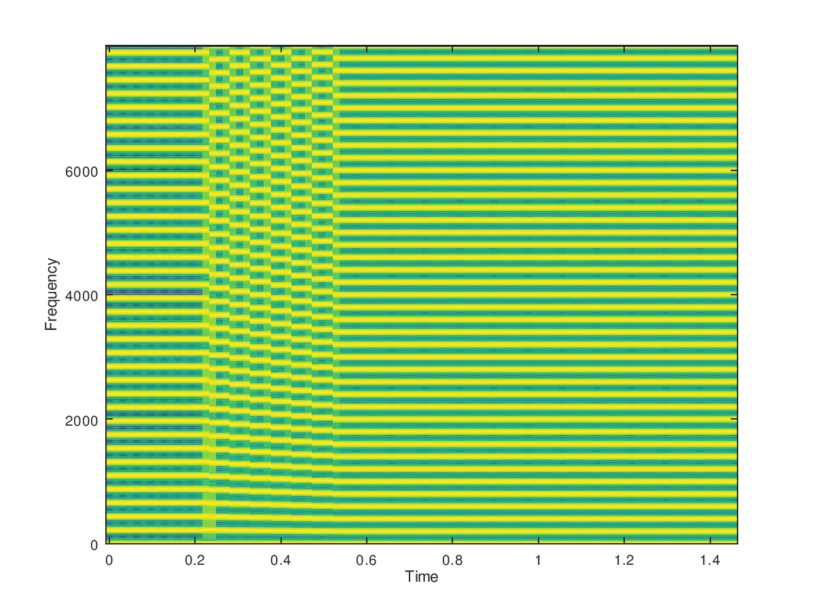

Slide 25
Application to synthesis example
Original speech
The vocal tract filter is computed for each speech frame and an impulse train is used to drive the filter at a constant pitch
The same set of vocal tract filters are used but with a white noise excitation
Using a good quality encoder algorithm based on this model

Slide 26
Pink trombone:
https://dood.al/pinktrombone/

Slide 27
Speech Synthesis
CS425

Slide 28
Basic Idea – Front end and back end
PG&E will file schedules on April 20.
TEXT ANALYSIS: Text to intermediate representation:
WAVEFORM SYNTHESIS: From intermediate representation to waveform

Slide 29
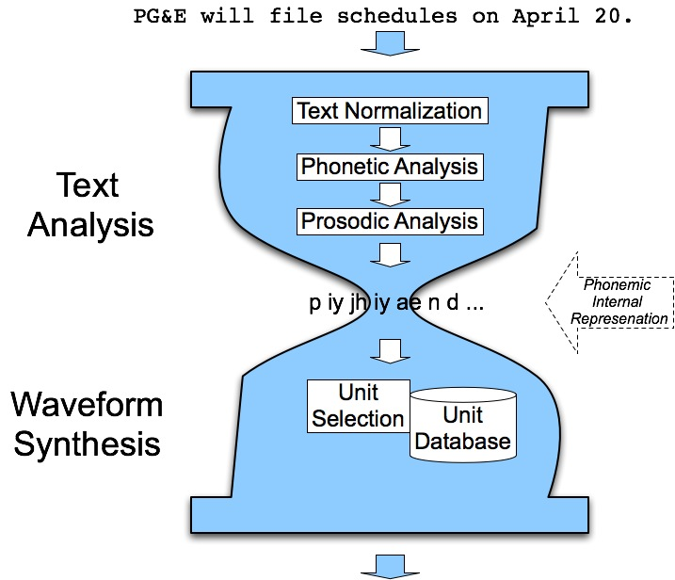
Hourglass idea

Slide 30
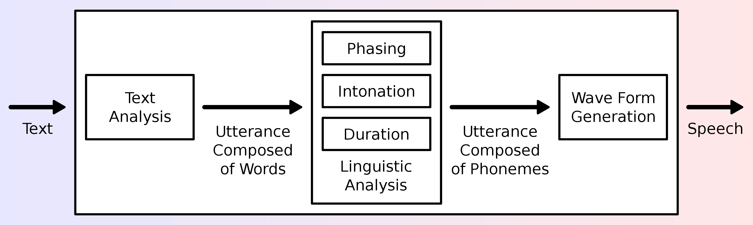
Overview of a typical TTS system

Slide 31
Basic Idea
Given:
String of phones
Prosody
Desired F0 for entire utterance
Duration for each phone
Stress value for each phone, possibly accent value
Intensity?
Generate/find:
Waveforms

Slide 32
The earliest work
The earliest efforts to produce synthetic speech were made over two hundred years ago.
In St. Petersburg 1779 Russian Professor Christian Kratzenstein explained physiological differences between five long vowels (/a/, /e/, /i/, /o/, and /u/) and made an apparatus to produce them artificially.
He constructed acoustic resonators similar to the human vocal tract and activated the resonators with vibrating reeds like in music instruments.

Slide 33
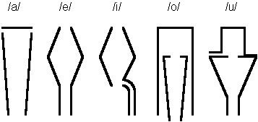
Kratzenstein’s Vowel Resonators
See here for an example http://www.phon.ucl.ac.uk/home/mark/vowels/

Slide 34
Other Devices
Later in Vienna in 1791, Wolfgang von Kempelen introduced his "Acoustic-Mechanical Speech Machine", which was able to produce single sounds and some sound combinations
He studied speech and contributed much to the theory that the vocal tract, a cavity between the vocal cords and the lips, is the main site of acoustic articulation.
In about mid 1800's Charles Wheatstone constructed a version of von Kempelen's speaking machine. It was more complicated and was capable of producing vowels and most of the consonant sounds. It was also possible to generate some sound combinations and even full words.
See https://www.youtube.com/watch?v=k_YUB_S6Gpo

Slide 35
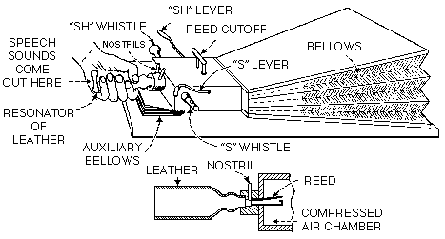
Wheatstone’s speaking machine

Slide 36
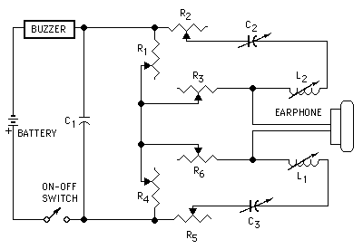
Electrical Machines
The first full electrical synthesis device was introduced by Stewart in 1922. The synthesiser had a buzzer as excitation and two resonant circuits to model the acoustic resonances of the vocal tract. The machine was able to generate single static vowel sounds with two lowest formants, but not any consonants or connected utterances.

Slide 37
Early Speech Synthesis Examples
See
http://www.festvox.org/history/klatt.html

Slide 38
Homer Dudley
The first device to be considered as a speech synthesizer was VODER (Voice Operating Demonstrator) introduced by Homer Dudley in New York World's Fair 1939
VODER was inspired by VOCODER (Voice Coder) developed at Bell Laboratories in the mid-thirties. The original VOCODER was a device for analyzing speech into slowly varying acoustic parameters that could then drive a synthesizer to reconstruct the approximation of the original speech signal.
The VODER consisted of wrist bar for selecting a voicing or noise source and a foot pedal to control the fundamental frequency. The source signal was routed through ten bandpass filters whose output levels were controlled by fingers.

Slide 39
Homer Dudley
It took considerable skill to play a sentence on the device. The speech quality and intelligibility were far from good but the potential for producing artificial speech was well demonstrated.
The basic structure and idea of VODER was very similar to present systems which are based on the source-filter-model of speech.

Slide 40
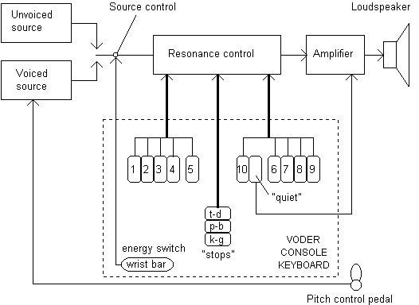
Homer Dudley
See https://www.youtube.com/watch?v=0rAyrmm7vv0

Slide 41
Parallel/Cascade Formant Synthesis
The first formant synthesizer, PAT (Parametric Artificial Talker), was introduced by Walter Lawrence in 1953. It consisted of three electronic formant resonators connected in parallel. The input signal was either a buzz or noise.
At about the same time Gunnar Fant introduced the first cascade formant synthesizer OVE I (Orator Verbis Electric) which consisted of formant resonators connected in cascade.
PAT and OVE synthesisers engaged a debate about whether the transfer function of the acoustic tube (vocal tract) should be modelled in parallel or in cascade.

Slide 42
Parametric synthesis
In mid 1960s, first experiments with Linear Predictive Coding (LPC) were made. This could be used for speech coding/compression, where speech waveforms would be reduced to a small number of parameter values
Linear prediction was also used in low-cost synthesis systems, such as Texas Instruments Speak'n'Spell in 1980. Its quality was quite poor compared to present systems.
The first full text-to-speech system for English was developed in the Electro-technical Laboratory, Japan 1968. The speech was quite intelligible but monotonous.
In 1979 the MITalk laboratory text-to-speech system was developed at M.I.T.. Two years later Dennis Klatt introduced his famous Klattalk system, which used a new sophisticated voicing source.

Slide 43
Summary of Modern techniques
Synthesised speech can be produced by several different methods. The methods are usually classified into three groups:
Articulatory synthesis, which attempts to model the physics of the human speech production system directly.
Formant synthesis, which models the resonances of vocal tract assuming a Linear speech model.
Concatenative synthesis, which uses different length pre-recorded samples derived from natural speech
AI synthesis

Slide 44
Articulatory Synthesis
Articulatory synthesis tries to model the human vocal organs as perfectly as possible using physics, so it is potentially the best way to produce high-quality synthetic speech.
The data for articulatory model is usually derived from X-ray analysis of natural speech. The articulatory parameters include lip aperture, lip protrusion, tongue tip height, tongue tip position, tongue height, tongue position and velic aperture. Phonatory or excitation parameters may be glottal aperture, cord tension, and lung pressure. When speaking, the vocal tract muscles cause these articulators to move and change shape of the vocal tract which causes different sounds.
It is the most difficult method to implement for reasons such as x-ray data is only 2-D, not 3-D, and the movement of the tongue is very complicated to model.
With so many parameter values for the model the computational load is considerably higher. Thus, to date it is not as mature as other methods.

Slide 45
Articulatory synthesis example
https://www.youtube.com/watch?v=1fM204jqRDs
https://www.vocaltractlab.de/index.php?page=vocaltractlab-examples

Slide 46
Formant Synthesis
Until recently, this has been the most widely used synthesis method. It is based on the source-filter(Linear) model of speech.
There are two basic structures, parallel and cascade, but for better performance some kind of combination of these is usually used.
Formant synthesis can generate an infinite number of sounds which makes it more flexible than concatenation-based methods for example.
At least three formants are generally required to produce intelligible speech and up to five formants to produce high quality speech. Each formant is usually modelled with an IIR resonator filter which enables both the formant frequency and its bandwidth to be specified. The excitation signal normally is some kind of buzzy sound to represent the voiced source and white noise for the unvoiced source.

Slide 47
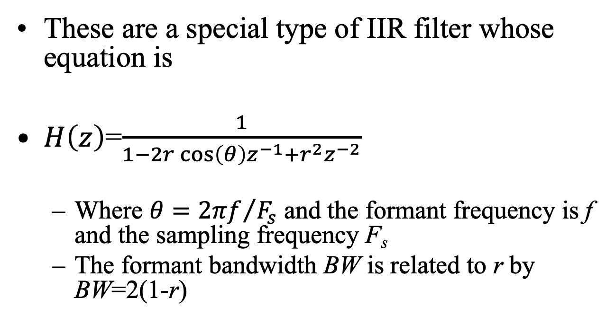
Resonator Filters
These are a special type of IIR filter whose equation is
$H\left(z\right)$=$\frac{1}{1−2r\cos\left(θ\right)z^{−1}+r^{2}z^{−2}}$
Where $θ={2πf}/{F_{s}}$ and the formant frequency is f and the sampling frequency F_{s}
The formant bandwidth BW is related to r by BW=2(1-r)

Slide 48
Example Spectra – Cascade System

Slide 49
Example Spectra – Parallel System

Slide 50
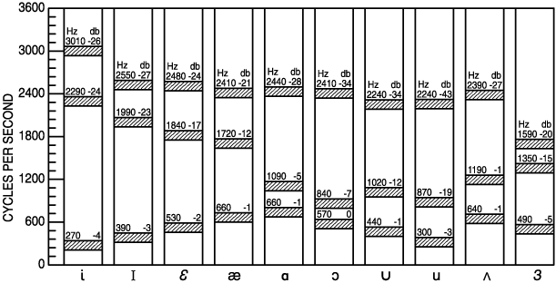
Average Formant Locations for American English Vowels

Slide 51

Cascade Formant Synthesizer
A cascade formant synthesiser consists of band-pass resonators connected in series and the output of each formant resonator is applied to the input of the following one.

Slide 52
Cascade Formant Synthesizer
The main advantage of the cascade structure is that the relative formant amplitudes for vowels do not need individual controls. It is thus simpler to implement.
This structure has been found to be better for generating non-nasal voiced sounds.
However, with cascade model the generation of fricatives and plosive bursts is a problem

Slide 53
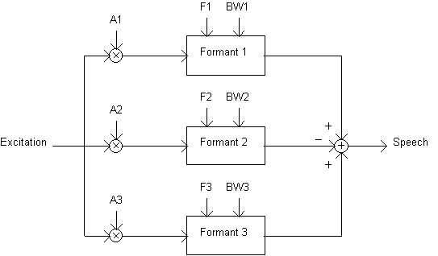
Parallel Formant Synthesizer
A parallel formant synthesiser consists of resonators connected in parallel. Sometimes extra resonators for nasals are used.

Slide 54
Parallel Formant Synthesizer
The excitation signal is applied to all formants simultaneously and their outputs are summed.
The parallel structure enables controlling of bandwidth and gain for each formant individually and thus needs more control information.
The parallel structure has been found to be better for nasals, fricatives, and stop-consonants.
However, some vowels sound less convincing when produced with a parallel formant synthesiser in comparison to the cascade one.

Slide 55
Klatt Synthesizer
In 1980 Dennis Klatt proposed a more complex formant synthesiser which incorporated both the cascade and parallel synthesisers with additional resonances and anti-resonances for nasalised sounds, a sixth formant for high frequency noise, a bypass path to give a flat transfer function, and radiation characteristics.
Klatt introduced a sophisticated voicing source model. It was controlled by 39 parameters updated every 5 ms. A correct and carefully selected set of parameter values for the excitation is important especially when good control of the synthetic speech characteristics is desired.
The quality of Klatt Formant Synthesiser was very good and the model was incorporated into several TTS systems, such as MITalk, and DECtalk.

Slide 56
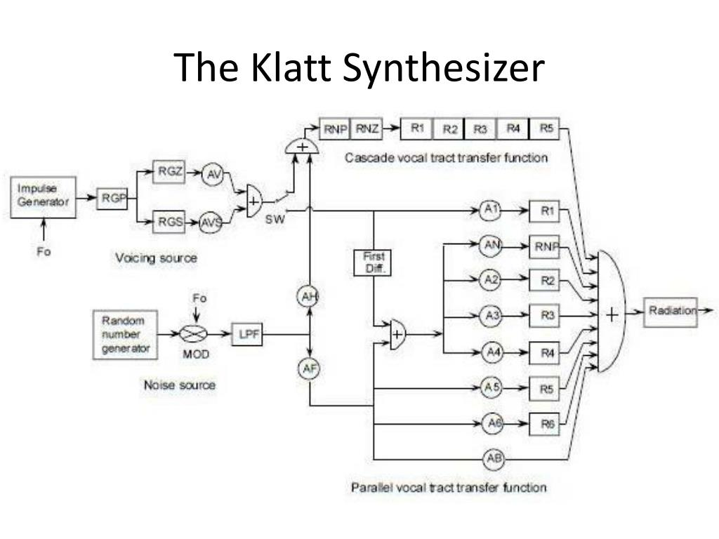
Klatt Synthesizer

Slide 57
Speak and Spell
The original Speak and Spell was introduced at the Consumer Electronics Show in 1978.
It contained a library of several hundred “frequently misspelled words.” The machine would say one out loud, and the user would type it via the keyboard.
It had a variant of formant synthesis. It contained 59 discrete speech sounds (called allophones). Each speech sound was taken from a word and decomposed into an excitation and filter parameters that were reconstructed

Slide 58
Speak and Spell
Speak & Spell came with several hundred words that were recorded, then processed and edited to play correctly using the vocal emulation-it could not generate new words
Its technology was followed by the SP0256-AL2 Integrated Circuit that contained 59 allophones for synthesizing words.
This approach was a bridge between Formant Synthesis and Concatenative synthesis
https://sha.nnoncarey.com/
https://www.youtube.com/watch?v=RpeegJ0J5mE

Slide 59
Concatenative Synthesis
Festival
https://www.cs.cmu.edu/~awb/festival_demos/userin.htmll
Cepstral
https://www.cepstral.com/en/demos
From text to speech
http://www.fromtexttospeech.com/
MBROLA
http://www.muflone.com/en/gespeaker/demo
https://github.com/numediart/MBROLA
https://web.archive.org/web/20041230164805/http://tcts.fpms.ac.be/synthesis/mbrola.html

Slide 60
Concatenative synthesis
https://wizzardsoftware.com/

Slide 61
Concatenative Synthesis
FreeTTS
http://freetts.sourceforge.net/demo/freetts/HelloWorld/README.html

Slide 62
Concatenative Synthesis - Concept
Record a basic inventory of speech sounds
Retrieve the appropriate sequence of units at run time
Concatenate and adjust durations and pitch to get the correct feel
Synthesize the final speech waveform

Slide 63
Concatenative Synthesis
Connecting pre-recorded natural utterances is probably the easiest way to produce intelligible and natural sounding synthetic speech.
The downside of this is that concatenative synthesisers
Require more memory than other technologies to store the sounds
Suffer from audible discontinuities when the sounds don’t join correctly
are limited, in the sense that each speaking voice requires its own set of recorded samples

Slide 64
Picking the Length of the sounds
A key problem in concatenative synthesis is thus to find best unit length, that is, the length of the speech units that will be joined together to make the sound
The selection is usually a trade-off: with longer units high naturalness, less concatenation points and good control of coarticulation are achieved, but the amount of required units and memory is increased.
With shorter units, less memory is needed, but the sample collecting and labelling procedures become more difficult and complex. Furthermore, there is a greater likelihood of discontinuity problems when joining the units together.

Slide 65
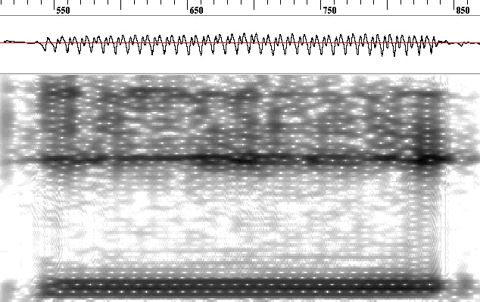
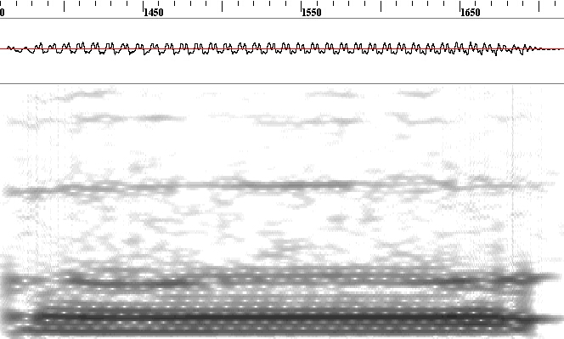
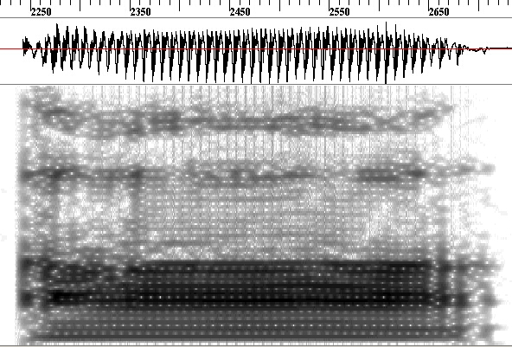
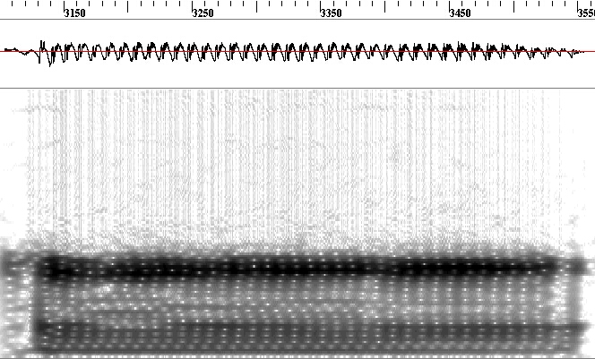
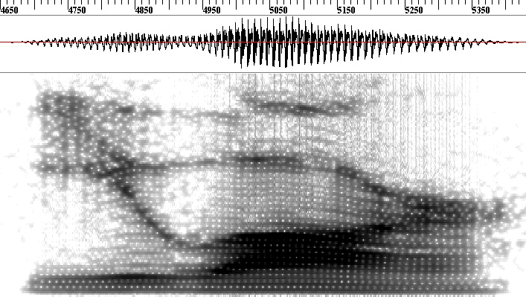
Coarticulation – Individual sounds vs altogether
time
frequency
j
u
ɑ
r
frequency
“you are”: /j u ɑ r/

Slide 66
Coarticulation – Formant Movement
frequency
j
u
ɑ
r
frequency

